Slide 1
Being More Productive with Type Declaration Files

Slide 2

Overview
Type declaration files
What are they?
Where do I get them?
How do I use them?

Slide 3
TypeScript wrapper for JavaScript libraries
Types for variables, functions, etc.
Define valid property names
Define function parameters
And much more!
Development-time tool Filenames end with .d.ts
Available for thousands of libraries
What Are Type Declaration
Files?

Slide 4
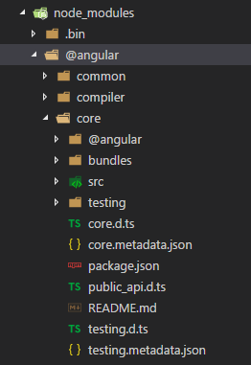
Obtaining Type Declaration Files

Slide 5
Github repository containing thousands of type declaration files
DefinitelyTyped
Declaration files often maintained independent of related JavaScript library
Source for installation utilities

Slide 6
Installed with npm
Packages installed from @types/<name> Sourced from the DefinitelyTyped repo
Installing Type Declaration
Files

Slide 7
Demo
Installing and using a type declaration file

Slide 8
Summary
Write code faster
Find errors faster Provide value faster

